Slide 1


Financial Highlights
As of September 30, 2022
One Minute Report – Click Below

Slide 2

Highlights of Interim Financial Report (unaudited)
September 30, 2022
BUDGET AMENDMENT REPORT for the October 19, 2022
Board meeting

Slide 3


Posted on Our Website
Finance / Monthly Finance Reports (hcde-texas.org)
Linked from State Comptroller’s website
http://www.texastransparency.org/local/schools.php

Slide 4

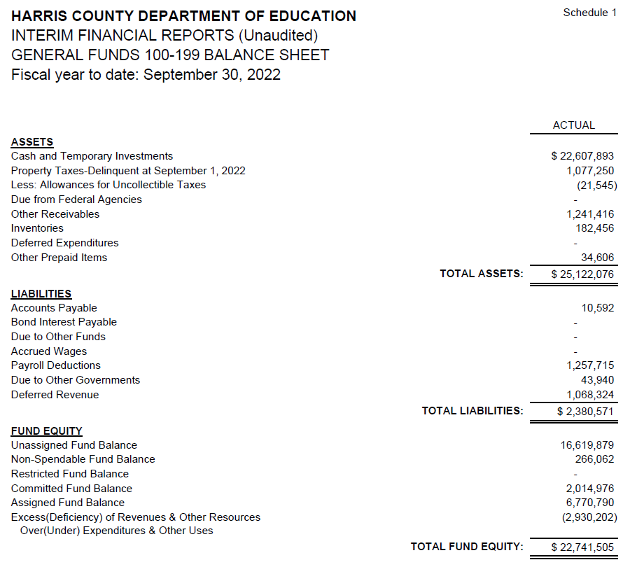
INTERIM FINANCIAL REPORT
(unaudited)
GENERAL FUND
Balance Sheet as of September 30, 2022
Total Assets:
$ 25,122,076
Total Liabilities:
$ 2,380,571
Total Fund Equity:
$ 22,741,505

Slide 5
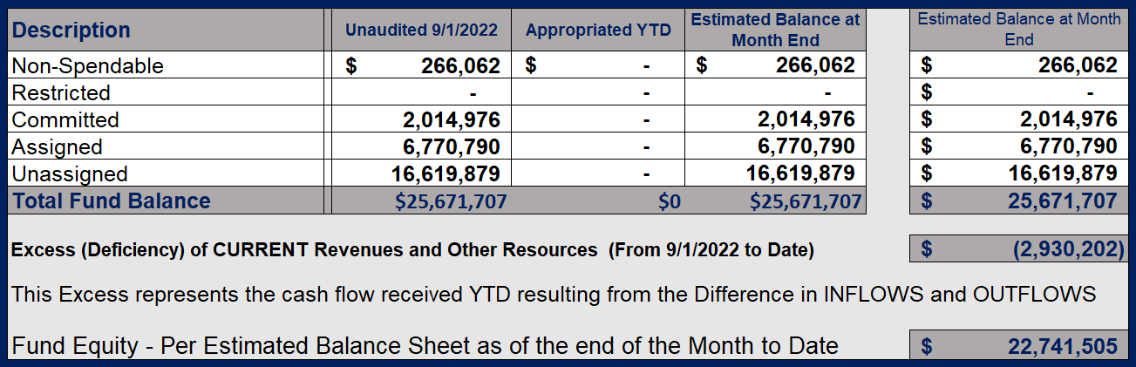
INTERIM FINANCIAL REPORT (unaudited)
ASST. SUPERINTENDENT FOR BUSINESS SERVICES MESSAGE
As of September 30, 2022
The ESTIMATED General Fund balance at 08/31/2022 is $23,986,726 after current appropriations.
As year end adjustments are completed, a budget amendment will be submitted to the board for items assigned, restricted and committed that will roll forward into FY 2023.

Slide 6
INTERIM FINANCIAL REPORT (unaudited)
As of September 30, 2022
Financial Ratios
Level One - Indicator of Financial Strength
Level Two - Indicator of Efficient Leverage
Level Three - Indicators of Efficiency
Level Four - Indicators of Revenue Growth

Slide 7
INTERIM FINANCIAL REPORT (unaudited)
As of September 30, 2022
Indicators of Financial Strength
Percent of Fund Balance to G/F
Expenditures Ratio
What is the percent of rainy fund balance?
(*) Unadjusted
Working Capital Ratio
What is the cash flow availability for the organization?
Unassigned Fund Balance $16,619,879
Total G/F Expenditures $3,447,746
Goal : > 30% of G/F Exp.
Benchmark: 10% to 29%
Danger: Under 10%
Goal : >$15,000,000
Benchmark : $10M to $15M
Danger : Under < $10M
Total Current Assets
Less Total Current Liabilities
$25,122,076 – 2,380,571 = 22,741,505
482% FY23
621% FY22
$23M FY23
$31M FY22
Budgeted 24%
Details on Schedule 3
Budgeted $33M
Details on Schedule 1

Slide 8
INTERIM FINANCIAL REPORT (unaudited)
As of September 30, 2022
Indicators of Efficient Leverage Reserves
Unassigned Fund Balance Ratio
How much is available in reserves?
Debt to Income Ratio
What is the ability of HCDE to cover its debt payments?
Unassigned Fund Balance $16,619,879
Total Fund Balance $25,671,707
Annual Principal and Interest Payments on
Term Debt and Capital Leases $0
G/F Revenue Less Facility Charges
517,544 - 234,151
Goal: <75%
Benchmark: 50% to 75%
Danger: <50%
Goal: <25% of annual revenue
Benchmark: 25% to <49%
Danger: Over > 50%
65% FY23
63% FY22
0% FY23
0% FY22
Budgeted 79%
Details on Schedule 1
Budgeted 8%
Details on Schedule 5

Slide 9
INTERIM FINANCIAL REPORT (unaudited)
As of September 30, 2022
Indicators of Efficiency
Tax Revenue to Total Revenue Ratio
How efficient is HCDE at leveraging local
taxes? (Current)
Indirect Cost to Tax Ratio
How much dependency on indirect cost from grants?
Current Tax Revenue $ 532
Indirect Cost General Fund $0
Total Revenue $1,710,454
Total General Fund Revenues $517,544
Goal: <20% of revenue
Benchmark: 20% to 30%
Danger: Over >30%
Goal: >5%
Benchmark: 2% to 5%
Danger: Under < 2%
0% FY23
0% FY22
0% FY23
0% FY22
Budgeted 22%
Details on Schedule 2
Budgeted 4%
Details on Schedule 3
Notes:
25,231,339

Slide 10
INTERIM FINANCIAL REPORT (unaudited)
As of September 30, 2022
Indicators of Revenue Growth
Fee for Service Revenue Ratio
How are revenues spread across all Funds?
Fee for Service Revenue Growth Ratio
What is the market growth for fee on services?
Total Fee for Service Revenues (G/F) $328,259
Total Revenues $1,710,454
Fee for Service Current Year Less Fee for Services Last Year $328,259 - 236,033
Fees for Service Last Year $236,033
Goal: >30% of annual revenue Benchmark: 10% to 29%
Danger: Under 10%
Goal: >3% of + growth
Benchmark: 0% to 3%
Danger: Under 0%
19% FY23
25% FY22
39% FY23
75% FY22
Budgeted 19%
Details on Schedule 14
Budgeted 7%
Details on Schedule 14

Slide 11
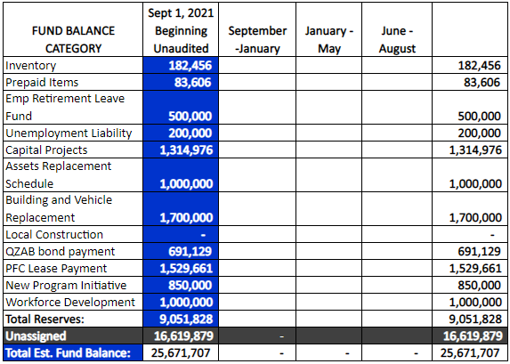
FY 2022-2023
Fund Balance
-
Budgeted Activity

Slide 12
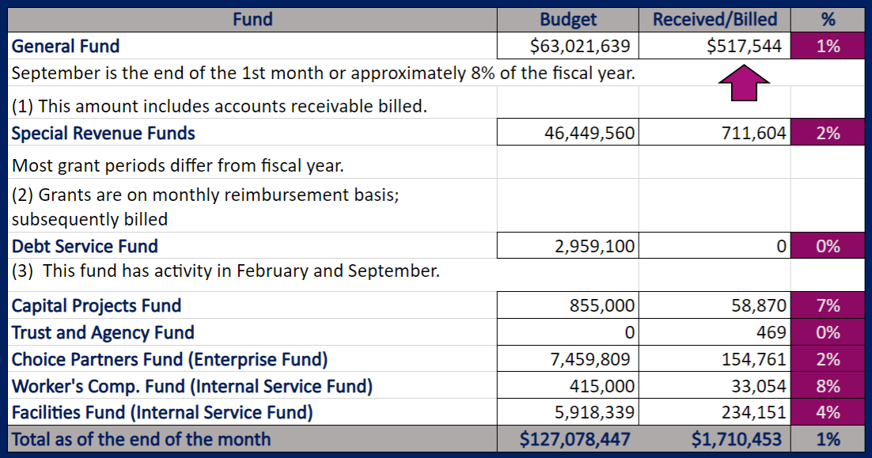
INTERIM FINANCIAL REPORT (unaudited)
GENERAL, SPECIAL REVENUE, DEBT SERVICE FUNDS, CAPITAL PROJECTS,
AND INTERNAL SERVICE FUNDS
REVENUES (INFLOWS)
Budget to Actual for period ending September 30, 2022

Slide 13
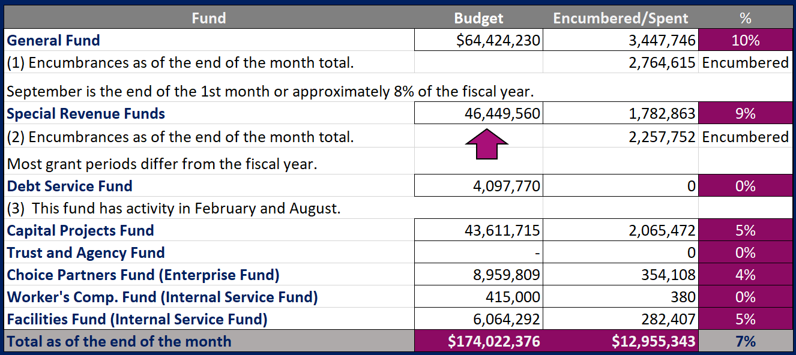
INTERIM FINANCIAL REPORT (unaudited)
GENERAL, SPECIAL REVENUE, DEBT SERVICE FUNDS, CAPITAL PROJECTS,
AND INTERNAL SERVICE FUNDS
Expenditures (OUTFLOWS)
Budget to Actual for period ending September 30, 2022

Slide 14
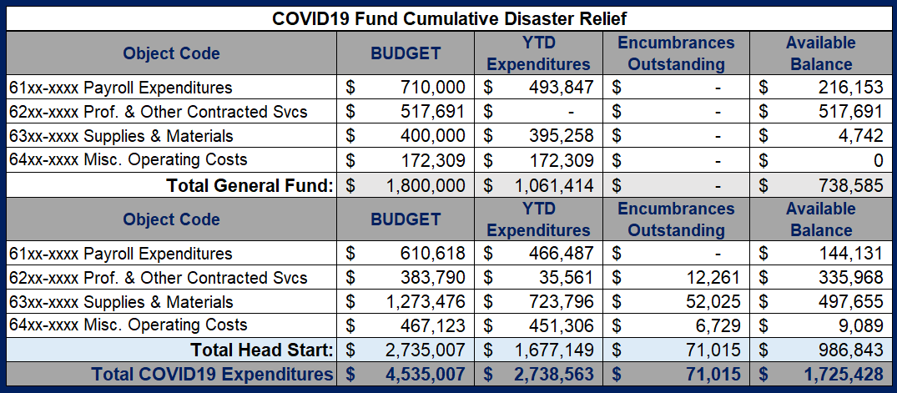
INTERIM FINANCIAL REPORT (unaudited) FY 2021 – 23 COVID19 Budget to Actual – Expenditures
for period ending September 30, 2022

Slide 15
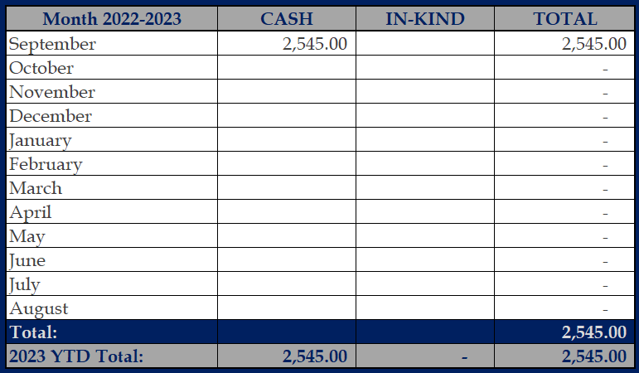
INTERIM FINANCIAL REPORT (unaudited)
FY 2022-23 Donations Report
All Funds as of September 30, 2022

Slide 16
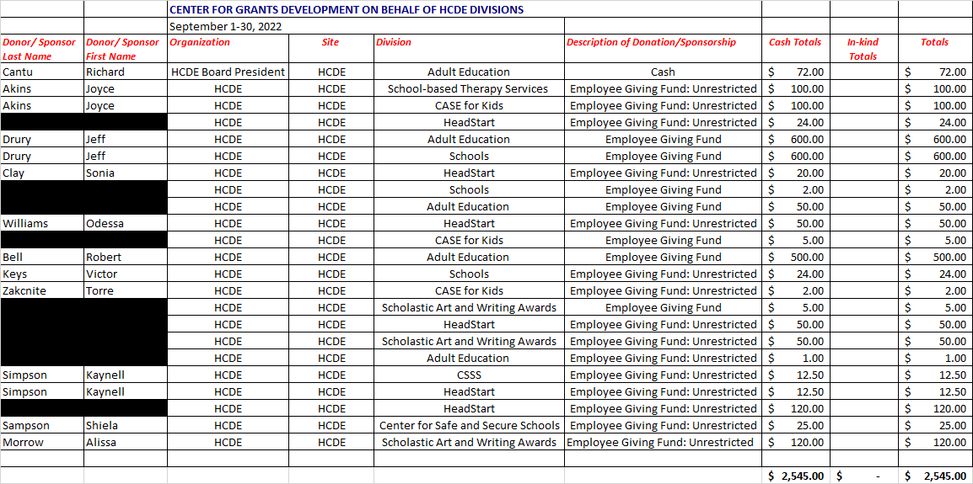
INTERIM FINANCIAL REPORT (unaudited)
FY 2022-23 Donations Report
All Funds as of September 30, 2022

Slide 17
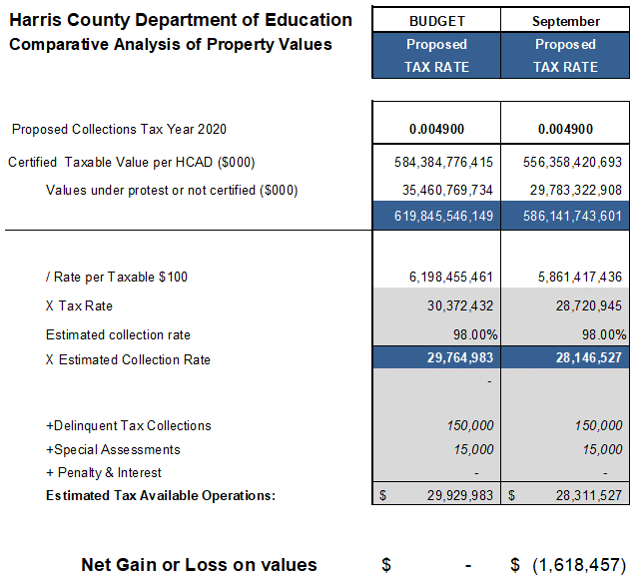
INTERIM FINANCIAL REPORT (unaudited)
TAX COLLECTIONS COMPARATIVE ANALYSIS
Fiscal Year-To-Date as of September 30, 2022
$586.1 B
See Tax Calculator at:
https://hcde-texas.org/transparency/tax-rate/
17

Slide 18
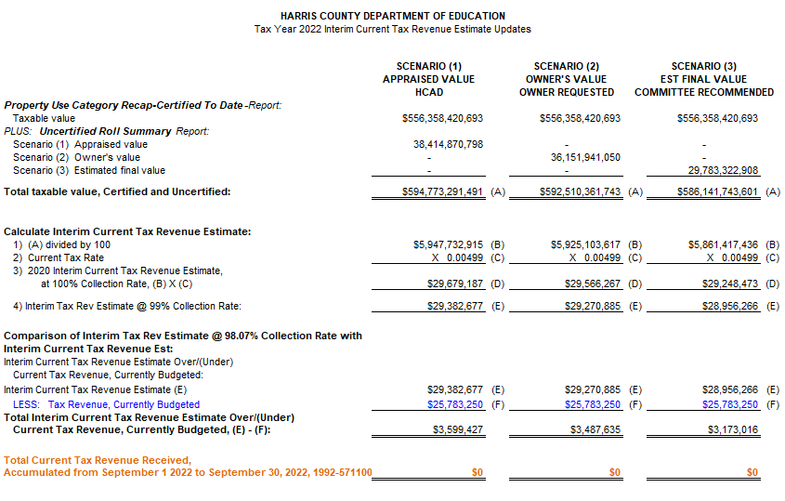
INTERIM FINANCIAL REPORT (unaudited) TAX COLLECTIONS
Fiscal Year-To-Date as of September 30, 2022
(1st month / 12 months)

Slide 19
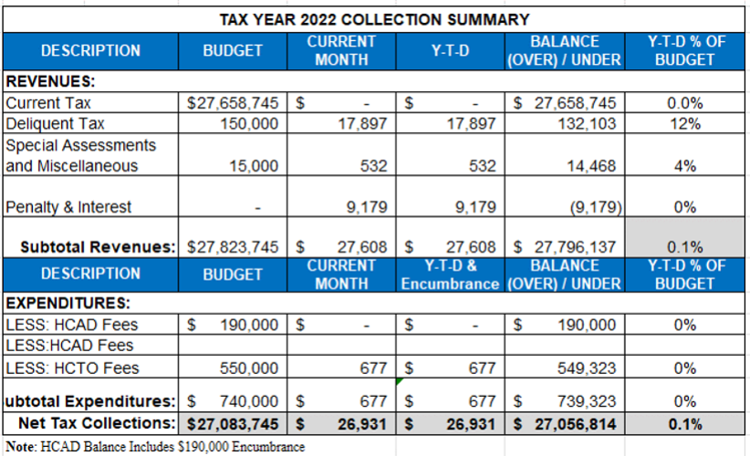
INTERIM FINANCIAL REPORT (unaudited) TAX COLLECTIONS
Fiscal Year-To-Date as of September 30, 2022
(1st month / 12 months)
a) 2022 Proposed Tax Rate = $0.004900/$100 Property Assessment/Appraisal - --> Annual Tax on a $259,375 - $75,219 = $201,066/100
x .004900 = $9.85 (net of 29% homestead exception.)
b) $705,000/$25,188,000 = 2.80% Collection and assessment costs

Slide 20
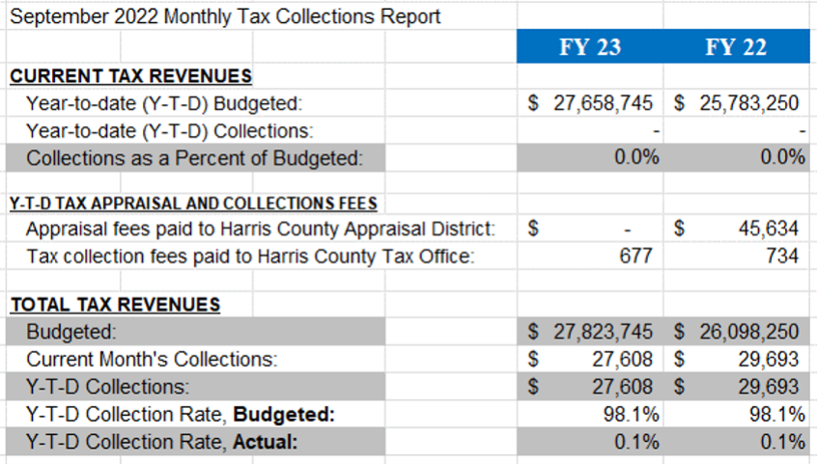
INTERIM FINANCIAL REPORT (unaudited) TAX COLLECTIONS
Fiscal Year-To-Date as of September 30, 2022
(1st month / 12 months)
2022 Proposed Tax Rate = $0.004900/$100 Property Assessment/Appraisal - --> Annual Tax on a $259,375 - $75,219 = $201,066/100 x .004900 = $9.85 (net of 29% homestead exception.)
b) $705,000/$25,188,000 = 2.80% Collection and assessment costs

Slide 21
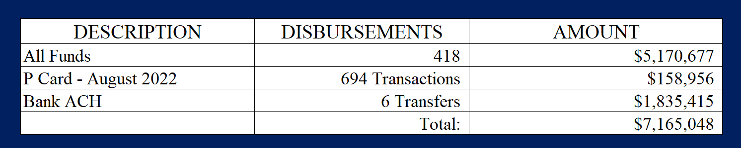
INTERIM FINANCIAL REPORT (unaudited)
DISBURSEMENT – ALL FUNDS
September 30, 2022
Notes:
All Purchase Orders and Payment Authorizations are reviewed before disbursement.
All Procurement Card charges are reviewed by cardholder, supervisor, and business office staff each month.
A report on CH Local Expenditures is included in the monthly report.

Slide 22
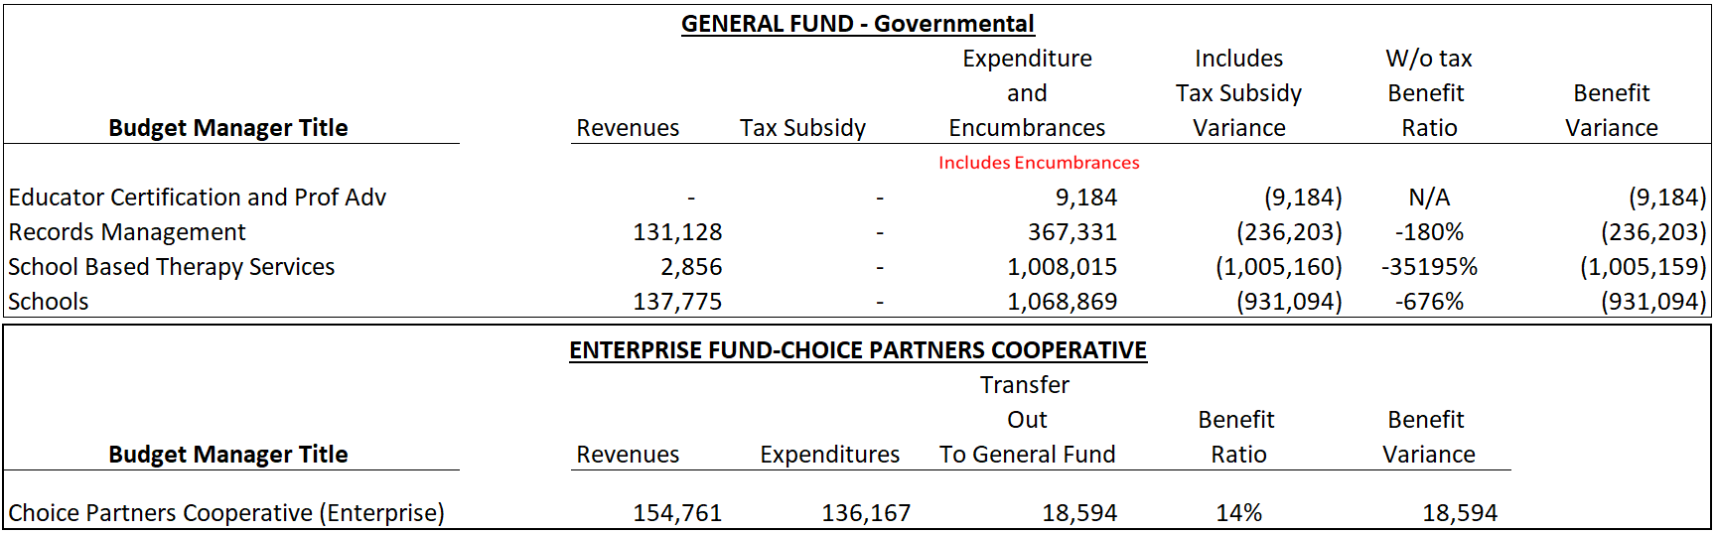
INTERIM FINANCIAL REPORT (unaudited)
Segment Division Data
As of September 30, 2022

Slide 23
HIGHLIGHTS OF BUDGET AMENDMENT REPORT
October 19, 2022 Board Meeting
(unaudited)
Amendments

Slide 24

Education Foundation Update
September 30, 2022

Slide 25
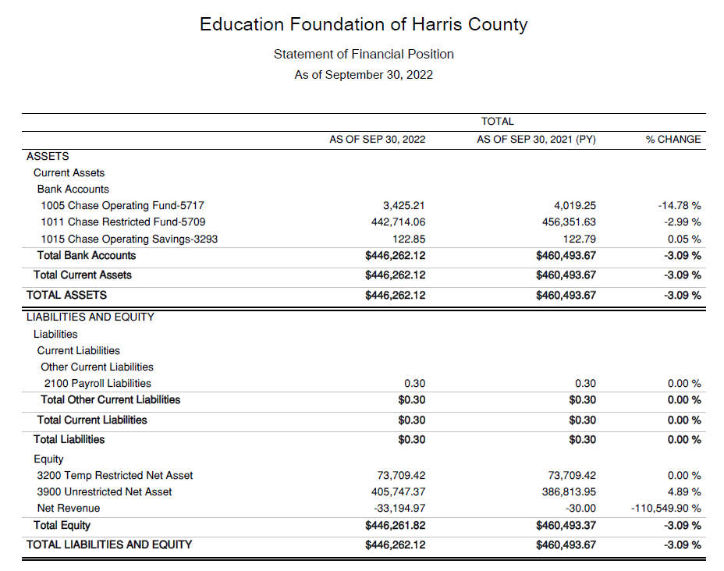
Statement of Financial Position
Net Equity $446,262

Slide 26
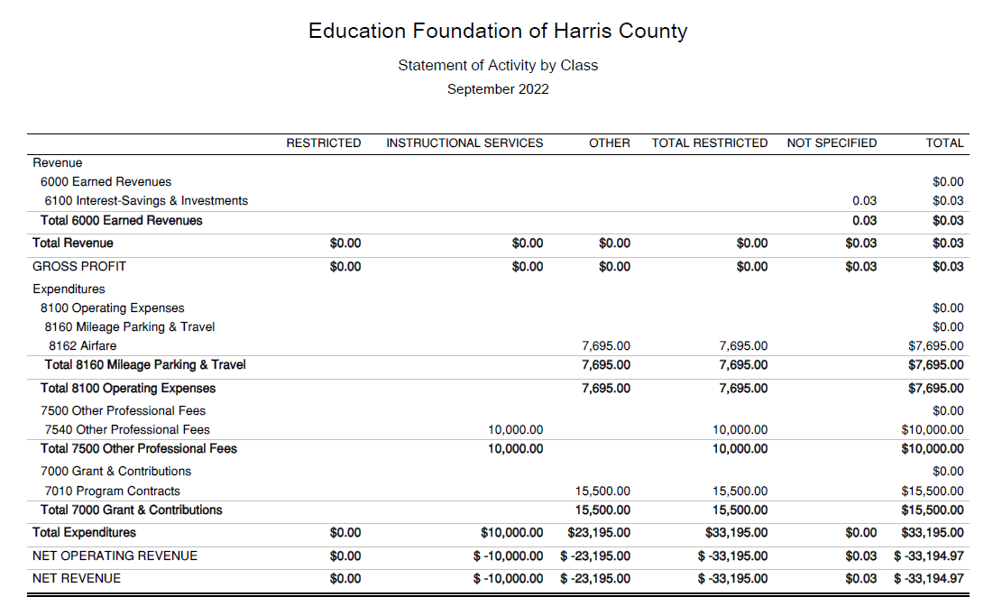
Statement of Activities Classified

Slide 27
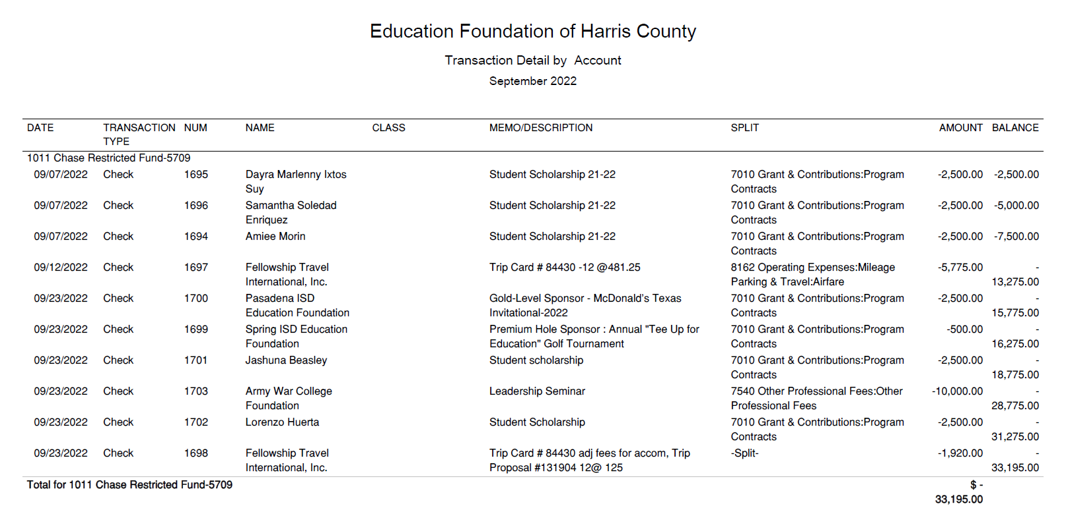




Transaction Detail by Inflow & Outflow

Slide 28
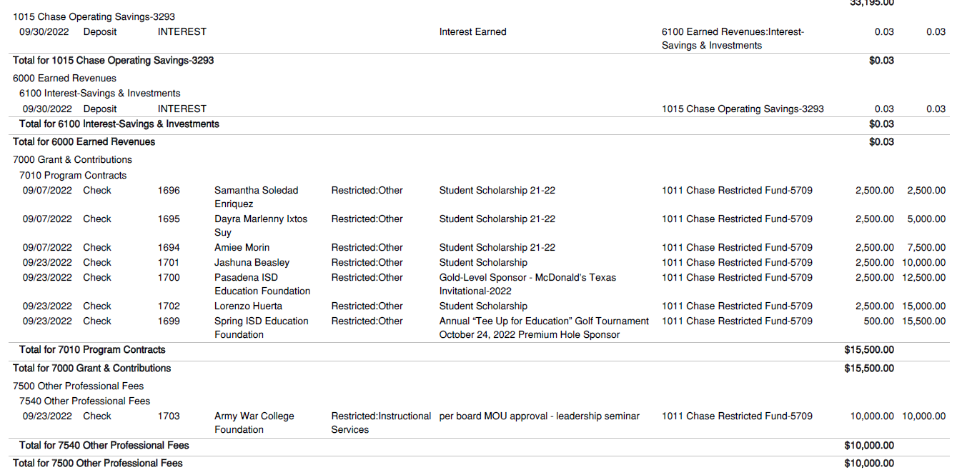
Transaction Detail by Inflow & Outflow (continued)

Slide 29
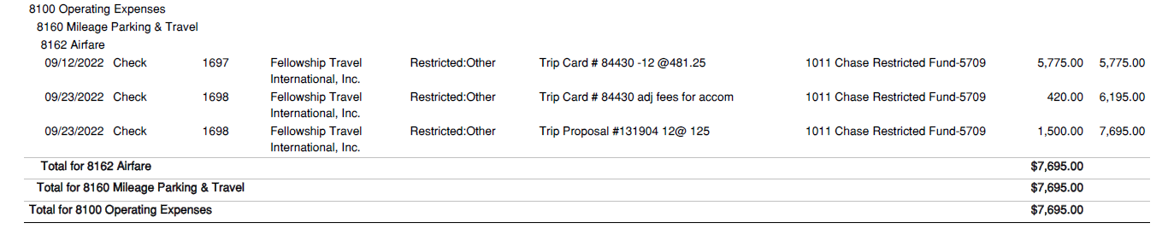
Transaction Detail by Inflow & Outflow (continued)

Slide 30
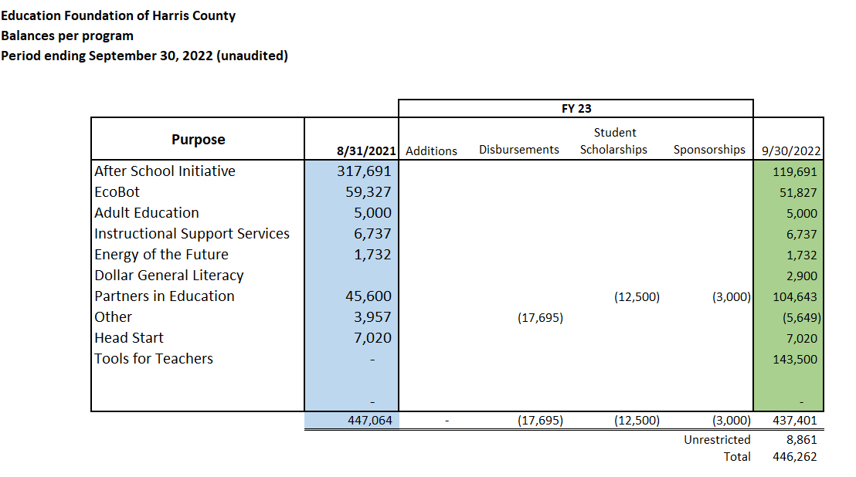
Balances Per Program

Slide 31

PFC & Lease Revenue Projects Update
September 30, 2022

Slide 32
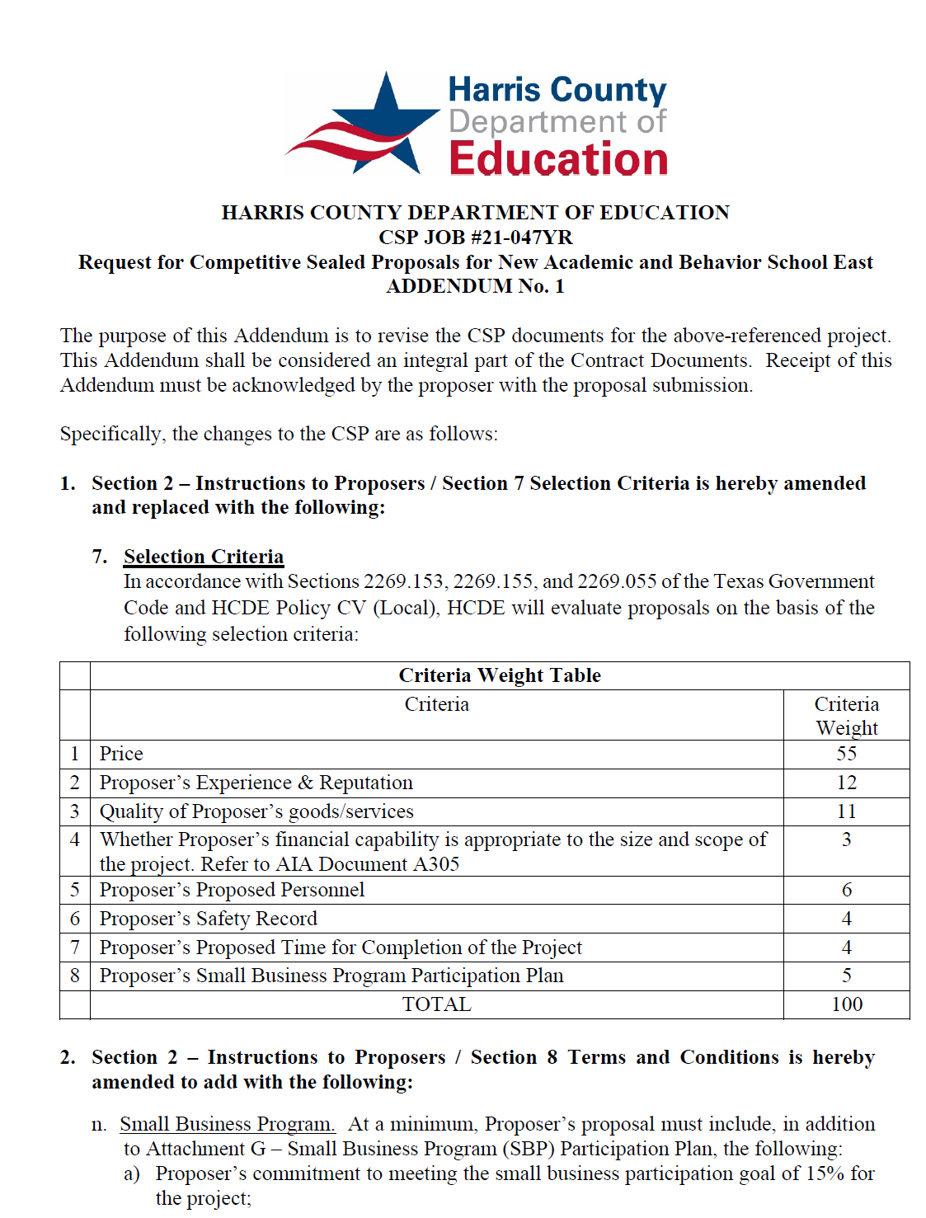
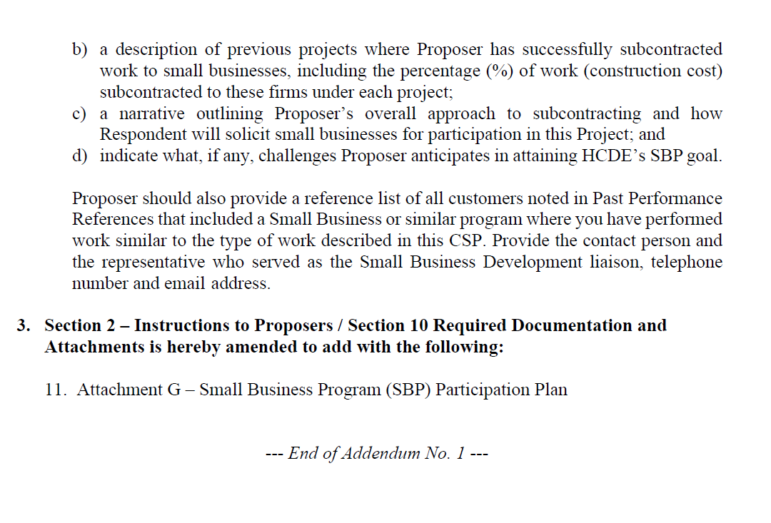
Small Business
Program for construction
Launch industry's first collaboration feature
This is our plan as we launch the industry's first collaboration feature

Slide 33
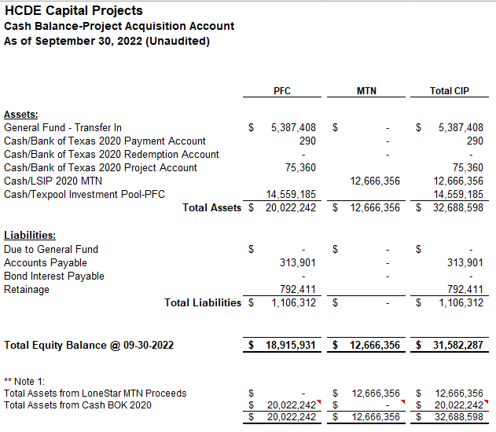

AB East School Contract $12,358,000 Awarded and Signed
Adult Ed Center Contract $15,121,000 awarded on Oct 2021 Board Mtg
HP East Contract $7,271,000 awarded on Nov 2021
Irvington – Pending Architect Assignment
Cash Balance –
Project Acquisition Account
As of September 30, 2022

Slide 34
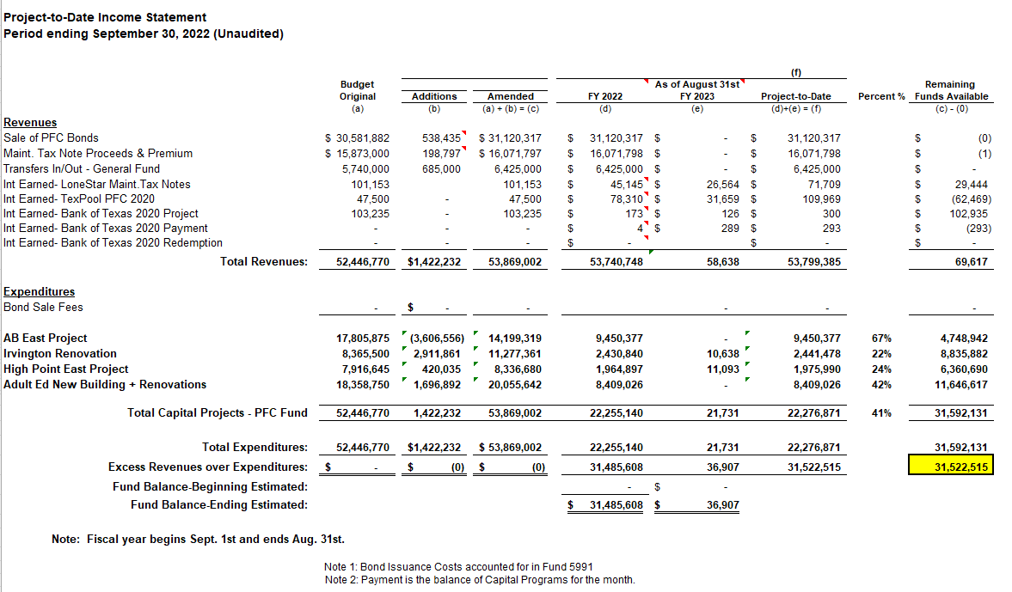
Income Statement– Project Acquisition Account
As of September 30, 2022

Slide 35
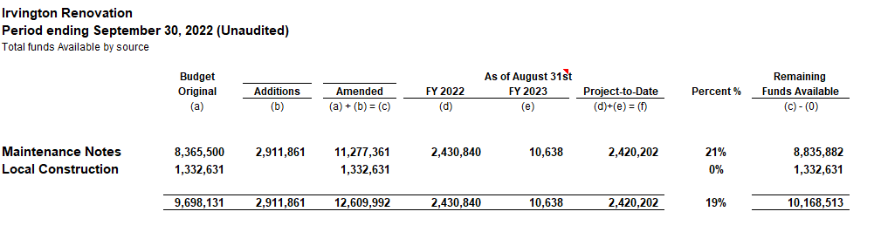
Irvington Renovation – Funds by Source
As of September 30, 2022
35

Slide 36

Capital Program Proposal from Aug 3, 2020

Slide 37






2020 Projected Capital Improvement Program
Project | Substantial Completion Date | Project Budget | Maintenance Notes Projected | Revenue Bonds Proceeds | General Funds Use of Fund Bal. | Interest Earnings Projection
Reagan Adm Bldg. | Feb 9, 2023 | $8,365,500 | $ 8,365,500 | N/A | N/A
Adult Ed Building | Oct 25, 2022 | $18,358,750 | $ 3,659,000 | $12,728,598 | $1,870,000 | $101,153
HP East Middle | Oct 25, 2022 | $7,916,645 | $ 1,089,500 | $4,909,645 | $1,870,000 | $47,500
Ab East Campus | Aug 16, 2022 | $17,805,875 | $ 2,759,000 | $12,943,640 | $2,000,000 | 103,235
 | Total | $52,446,770 | $15,873,000 | $30,581,882 | $5,740,000 | $251,888
 |  | Closed on 12-2-20 | Invested in pools.
Build a product accessible on all devices
This is our plan as we build a product accessible on all devices.
Note: The Total Public Notice was $54,000,000. ($35,000,000 for Revenue bonds and $19,000,000 for Maintenance Notes) on August 10, 2020. A transfer of $1,350,000 plus $50,000 in reimbursable expenditures was made from AB East to allocate Program Manager costs to establish the budgets.
Based on Pricing the principal amount will vary due to the premium projected in the bond sale. Revenues Bonds estimated at $27,730,000 and Maintenance Notes for $13,695,000

Slide 38

Interim Financial Report (Unaudited)
I certify that the foregoing information is true and accurate to the best of my knowledge.
/s/ Jesus J. Amezcua, RTSBA,CPA, Ph.D., CPFIM, Asst. Supt. for Business Support Services
/s/ Marcia Leiva, Chief Accounting Officer

